Slide 1
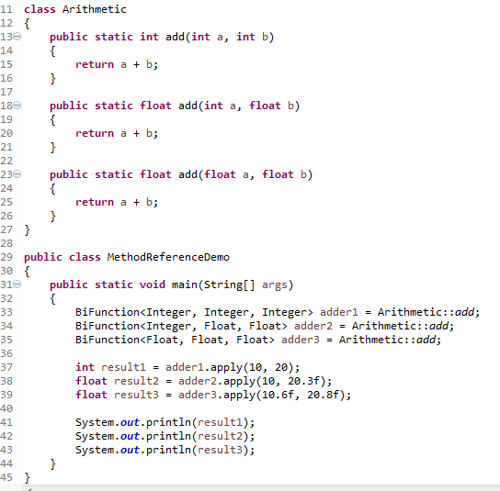
Java 8 Lambda : Comparator example

